Slide 1
HOUSIE (TAMBOLA) TICKET GENERATOR

Slide 2
What is housie?
Housie is a game of probability in which players mark off numbers on cards as the numbers are drawn randomly by a caller.
At the beginning of the game, all the players get a ticket (3x9matrix) in which there are total of 27 boxes and 15 of them are filled with a distinct random number from 1 to 90.
A caller calls a random number from 1 to 9 and the winner being the first person to mark off all their numbers.

Slide 3
Housie Ticket Rules
There are some rules to generate housie tickets and we can’t just randomly put 15 numbers in any boxes of our choice.
Let’s see the rules and then create a Python script that will generate such a housie ticket.

Slide 4
Here are the rules
#1 Each player must buy at least one ticket to enter a game.
#2 A typical 90 ball Housie ticket consists of 3 rows and 9 columns which make 27 spaces.
#3 Each row has a total of 5 numbers printed on it.
#4 A column can have 1, 2 or the maximum 3 numbers printed on it.
#5The first column in the ticket will have numbers from 1-9, the second column will have 10-19, third column with 20-29 and so on until the 9th column which will be numbered in between 80-90.
#6 A column must have atleast 1 number

Slide 5
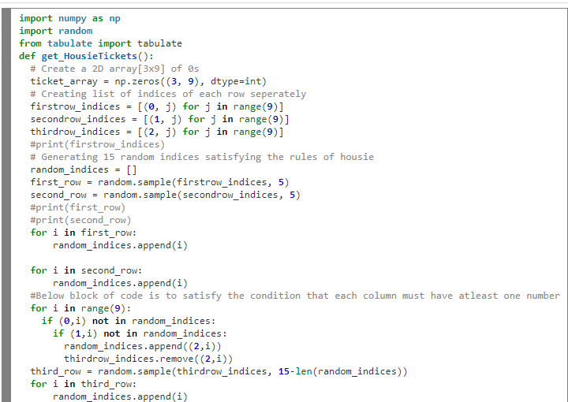
Python code for Ticket Generator

Slide 6
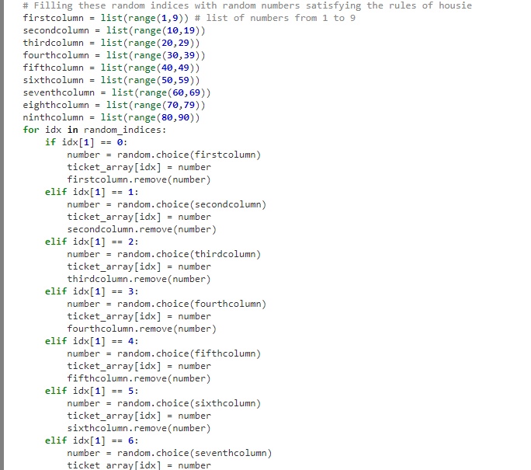

Slide 7
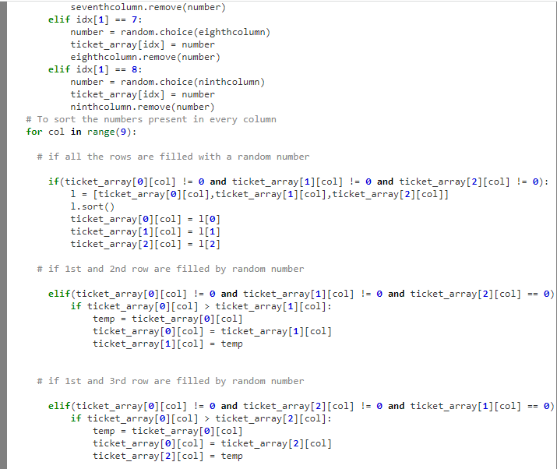

Slide 8
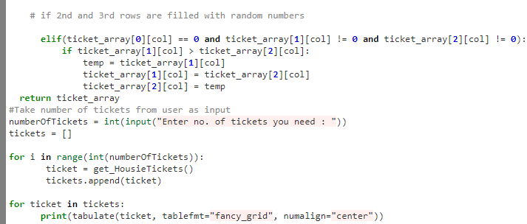

Slide 9
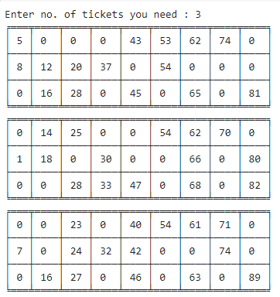
Output

